Slide 1
Mathematics (9-1) - iGCSE
2018-20
Year 09
Unit 03 – Answers

Slide 2
3 - Prior knowledge check
Page 631
3 - Prior knowledge check
a. 22 b. $\frac{27}{2}$ c. $\frac{59}{20}$
a. 11 b. 14 c. 3.5
a. 2 hours 12 minutes b. 4:11pm c. A
a. Mean = 2, median = 1, mode = 1, range = 5
Mean = 5.375, median = 4, mode = 3, range = 12
Mean 3.1 (1 d.p.), median = 4, mode = 5 and 1, range = 6

Slide 3
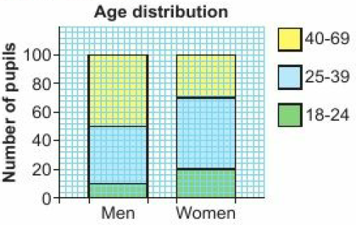
3 - Prior knowledge check
Page 631
a. 10% b. 20%
i. CT ii. T iii. T
a. 10 b. 5 c. March and June
January e. May
Boys given 6 more detentions than girls (133 versus 127).

Slide 4
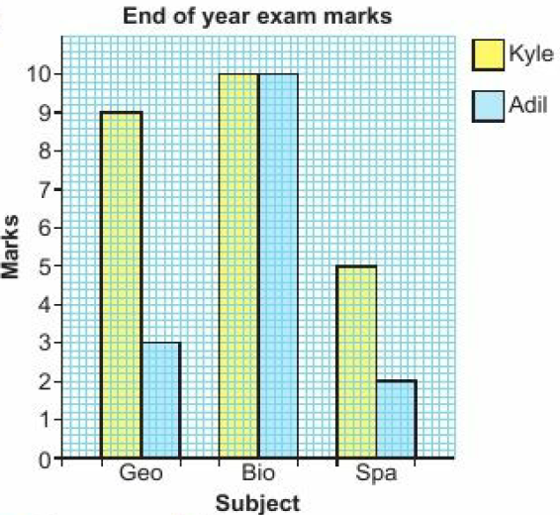
3 - Prior knowledge check
Page 631

Slide 5
3 - Prior knowledge check
Page 631
a. 6 b. 80
Correctly drawn pie chart with UK 165°, France 45°, Spain 90°, USA 60°.
a. 5 b. 25 c. 5
a. 5 b. 35 c. 2.1
On average families in rural communities have 1 child more than those living in the city.

Slide 6
3 - Prior knowledge check
Page 632
a. Key
20 c. 4
3 | 0 | 2 | 3 | 6 | 7 | 8 | 8
4 | 0 | 2 | 5 | 9
5 | 0 | 6
6 | 4 | 9
7 | 2 | 9
8 | 2 | 4 | 6
3 | 0 means 30

Slide 7
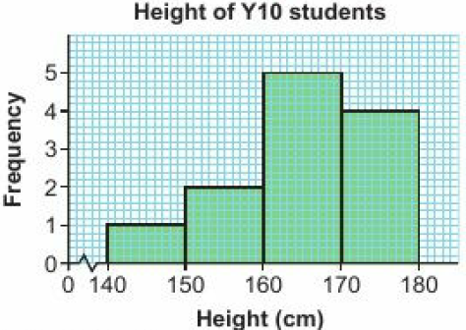
3 - Prior knowledge check
Page 632
Any suitable data collection sheet.
a. Continuous b. x = 4, y = 4
a. 4, 4, 6, 7, 14; no
4, 4, 4, 8, 8, 14 or 4, 4, 5, 7, 8, 14 or 3, 4, 4, 8, 10, 13

Slide 8
3.1 – Statistical Diagrams 1
Page 632
On average Sophie has a better score than Celia because her median is lower. She is also more consistent because her range is lower.
a. 750 b. Theatre
20000 x (45 ÷ 360) = 2500 at festival but only 1500 x (90 ÷ 360) = 375 at theatre
a. 10 b. 89kg c. 35kg d. 71kg
Yes; the number of people is 10 < 12 and total mass is 716 kg < 800 kg.
71.6 kg

Slide 9
3.1 – Statistical Diagrams 1
Page 632
Maths range = 54, English range = 37 Maths median = 60. English median = 58 The Maths marks are more spread out since the range for maths is far greater than the range for English. The average marks are very similar since the median mark for Maths is only 2 marks higher than the median English mark.

Slide 10
3.1 – Statistical Diagrams 1
Page 632
a. A B Key A B
 |  |  |  |  | 1 | 3 | 6
 | 9 | 9 | 6 | 4 | 2 | 3
 |  | 7 | 6 | 0 | 3 | 1 | 4 | 7 | 7 | 7 | 8 | 9
 |  | 8 | 7 | 6 | 4 | 2 | 2 | 3
 |  | 9 | 5 | 2 | 5 | 2 | 3
 |  |  |  |  | 6 | 4
4 | 2 Represents 24cm
1 | 3 Represents 24cm

Slide 11
3.1 – Statistical Diagrams 1
Page 632
b. For type A there is an even spread of tulips in the range 20 to 59cm because the numbers on the left-hand side appear as a block. For type 6 most tulips are between 30 and 39 cm, with a few shorter and a few taller, because the numbers show a distribution that is peaked at the centre and diminishes at either side of the centre.

Slide 12
3.1 – Statistical Diagrams 1
Page 632
a. 2 b. 37 c. 27 d. 27

Slide 13
3.1 – Statistical Diagrams 1
Page 632
a. 2 b. 37 c. 27 d. 27

Slide 14
3.1 – Statistical Diagrams 1
Page 632
a. 40 b. 25% c. 120 minutes
a. B b. About the same c. A

Slide 15
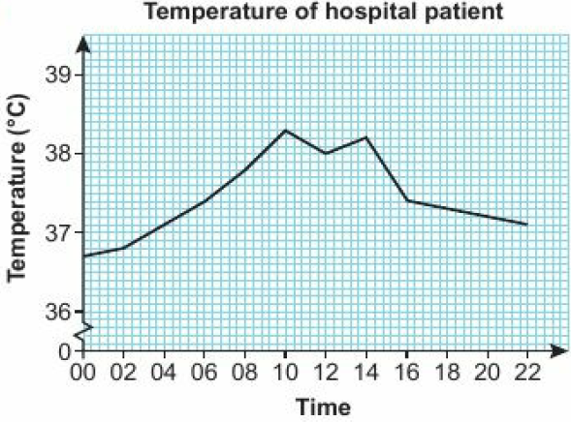
3.2 – Time Series
Page 632
a. ii b. iv c. i d. iii e. v
a. 4, 6 b. 39, 48
25%
a. 37.3⁰C b. 38.3⁰C c. 37.4⁰C
The temperature increased steadily between midnight and 10am, then fluctuated around 38°C for four hours. Between 14:00 and 16:00 it decreased sharply, then continued to decrease slowly until 22:00.

Slide 16
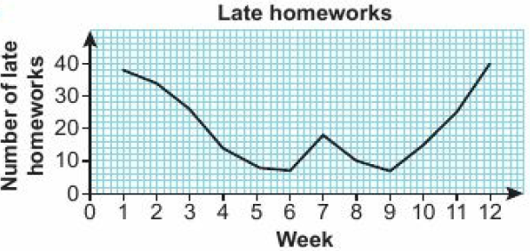
3.2 – Time Series
Page 632
a. The number of late homeworks starts off very high, decreases mid-term but then gets steadily higher during the last three weeks of term. There is small blip near half-term.

Slide 17
3.2 – Time Series
Page 633
a. £4.90
Yes; Magazine A has gone up by £3.40 whereas Magazine B has only risen by 90p.
Yes; the graph is bending downwards or the slope of the graph is going down.
e.g. Both magazines are likely to be the same price of about £7.50.

Slide 18
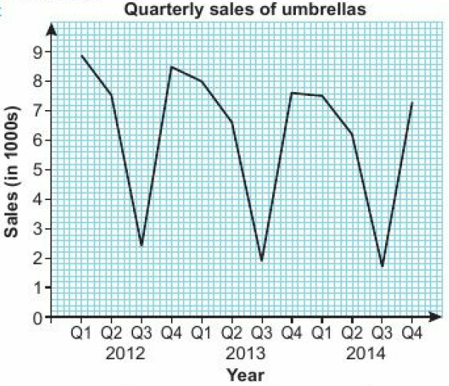
3.2 – Time Series
Page 633
a. 66,000
Q1 of 201?
Due to seasonal variations, sales fluctuate wildly. The overall trend is a decrease in sales.

Slide 19
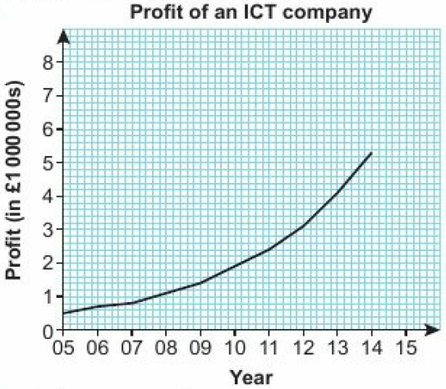
3.2 – Time Series
Page 633
a.
Profit increases at an increasing rate,
About £1.9 million
About £6.9 million

Slide 20
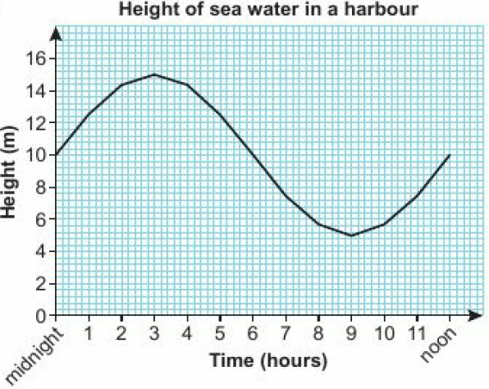
3.2 – Time Series
Page 633
a.
3 am
15m
Between 7am and 11am and again between 7 pm and 11 pm.

Slide 21
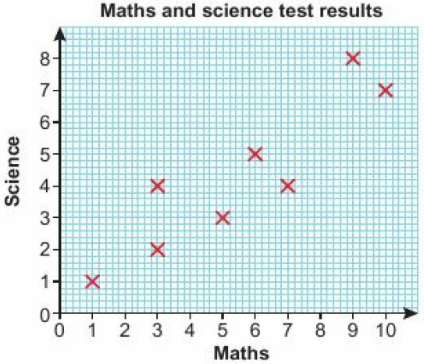
3.3 – Scatter Graphs
Page 633
a. Point A
a.
In general, students with higher maths scores got higher science scores and students with lower maths scores got lower science scores,

Slide 22
3.3 – Scatter Graphs
Page 633
a. No correlation; there is no relationship between price and temperature.
Negative correlation; as the price of ice creams increase, sales decrease.
Positive correlation; as the temperature increases sales of ice creams increase.

Slide 23
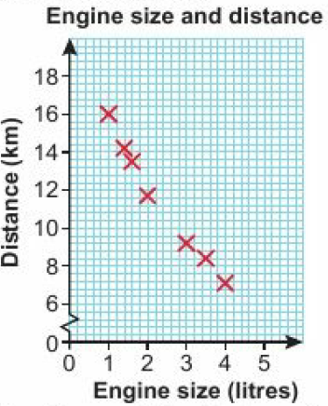
3.3 – Scatter Graphs
Page 633
a.
Negative correlation. The larger the engine the shorter the distance travelled on a litre of petrol.

Slide 24
3.3 – Scatter Graphs
Page 634
a.
No correlation; there is no relationship between the value of painting and the mark awarded.

Slide 25
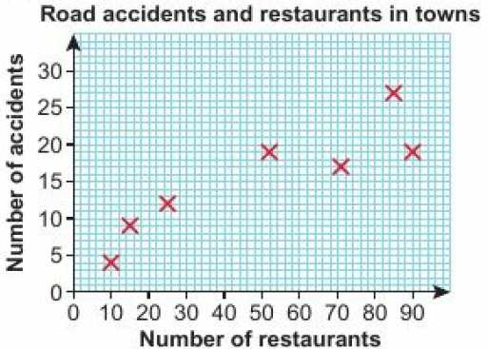
3.3 – Scatter Graphs
Page 634
a.
Positive correlation; cities with a larger number of takeaway restaurants tend to have a larger number of road accidents.
The data provides no support for the councillors views; although there is positive correlation it may not be one of cause and effect. Large, busy towns are likely to have both more takeaway restaurants and more accidents than small, quiet towns,

Slide 26
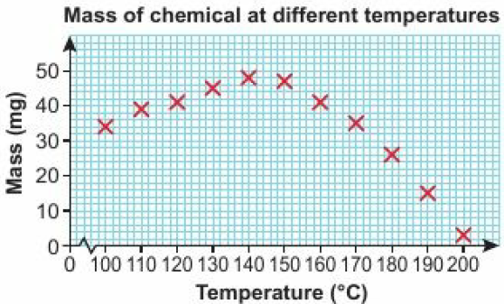
3.3 – Scatter Graphs
Page 634
a. Negative correlation b. Positive correlation c. No correlation
a.
Positive correlation at temperatures up to about 145 °C; negative correlation at temperatures over 145°C.
The mass increases to a maximum and then steadily decreases.
Approximately 50 mg at about 145°C

Slide 27
3.3 – Scatter Graphs
Page 634
a. Negative correlation. As money spent on quality control goes up the proportion of faulty mp3 players goes down.
4.2%
£73,000

Slide 28
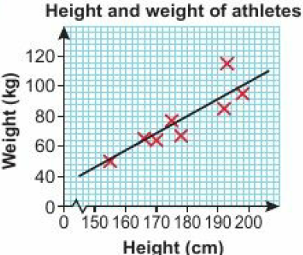
3.4 – Line of Best Fit
Page 634
a. 4 b. 3
C
a, b
About 85 kg d. About 163cm

Slide 29
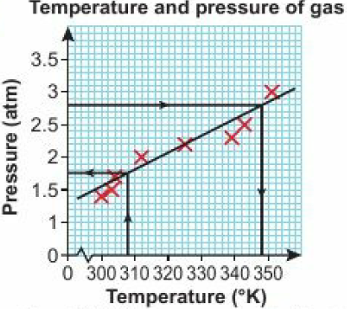
3.4 – Line of Best Fit
Page 634
About 349⁰K d. About 1.7 atm

Slide 30
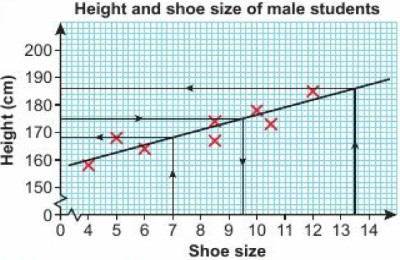
3.4 – Line of Best Fit
Page 634
i. About 9.5 ii. About 168cm iii. About 185cm
iii is the least reliable because it lies outside the range of the data points.

Slide 31
3.4 – Line of Best Fit
Page 634
a. Jack 2.9 and Joe 2.3
Jack’s estimate is more reliable. He uses more points and the points on his diagram are much closer to the line of best fit.
a.
The last point does not fit into the pattern of the other points. This might be due to an experimental misread or even a change in behaviour of the elastic when it is subject to a larger weight,
About 26 cm
About 10 cm

Slide 32
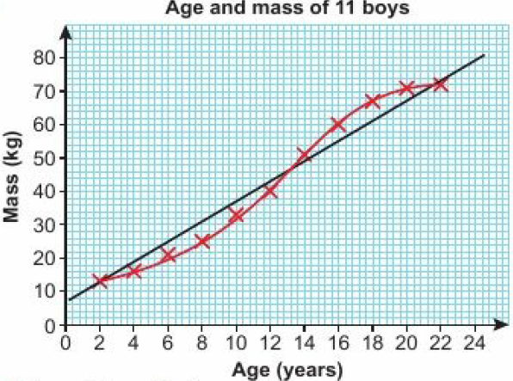
3.4 – Line of Best Fit
Page 635
a.
i. About 53 kg ii. About 81 kg
i is more reliable because the age of 15 is inside the data points whereas 24 is outside,
i. About 55 kg ii. About 72 kg
d is more reliable. The points nearly lie exactly on a smooth curve. This is a better fit of the data points. People have a growth spurt during their teenage years, this slows down till it stops at the age of 24 for boys so the graph should flatten off.

Slide 33
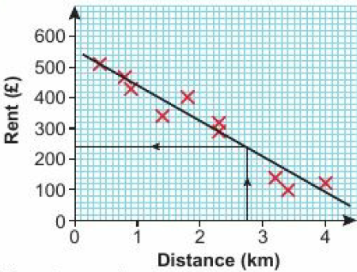
3.4 – Line of Best Fit
Page 635
a.
There is negative correlation between rent and distance. The further you live from the city the lower the monthly rent.
About £240

Slide 34
3.5 – Averages and Range
Page 635
a. 14 b. 1
a. 15.5 b. 30
a. Mean £19400, median £15000, mode £12000
Median; mean is distorted by one high salary and mode is lowest salary so neither of these give a typical salary.
a. Mean 8.375, median 7.75, mode 7
Mode; this is the popular shoe size so it makes sense to order what customers are likely to want to buy. The values of mean and median aren't proper shoe sizes.

Slide 35
3.5 – Averages and Range
Page 635
a. Mean £212, median £190, mode £180
Mean which takes into account all five values and could be used to work out the total bill.
a. Median; the low value of 6s distorts the mean, making it too low, and the mode gives the longest time so neither of these are typical.
Mode; the data is qualitative so you cannot work out the mean or median.
a. Outlier 7 kg, range 25 kg
Outlier £38,000, range £24000

Slide 36
3.5 – Averages and Range
Page 635
a. 2.9 and 500 are outliers, which are probably misreadings so should be ignored; 18 °C
-£250000 is an outlier and without any information to the contrary is probably correct and just a bad year so should be included; £400000.
a. Mean = 8.4625
£33.85
Time, T, (minutes) | Frequency, f | Mid-point, x | xf
0 ≤ T < 4 | 27 | 2 | 2 x 27 = 54
4 ≤ T < 10 | 34 | 7 | 7 x 34 = 238
10 ≤ T < 20 | 15 | 15 | 15 x 15 = 225
20 ≤ T < 60 | 4 | 40 | 40 x 4 = 160
Total | 80 |  | 677

Slide 37
3.5 – Averages and Range
Page 635
a. 3 b. 8 c. 16 d. 20 ≤ t < 30
There are 21 data values, so the median is in position $\frac{21 + 2}{2}$ = 11
20 ≤ t < 30
a. 36
The total number of items is 36, so the median is at number $\frac{36 +1}{2}$ = 18.5
7.5 ≤ d < 8.0 d. 7.0 ≤ d < 7.5
Ben f. 7.5 ≤ d < 8.0
Jamie, because he has done more jumps in training over 8.0

Slide 38
3.5 – Averages and Range
Page 635
a. 6
Mean
= $\frac{\left(1 x 1\right) + (3 x 3)+(5 x 4)+(7 x 2)+(9 x 3)+(11 x 2)+(13 x 1)+(15 x 2)+(17 x 4)+(19 x 0)}{22}$
= $\frac{1+9+20+14+27+22+13+30+68}{22}$
= 9.27, so no compensation.

Slide 39
3.6 – Statistical Diagrams 2
Page 635
a. Pie chart with Tea 72⁰, Coffee 180⁰, Cola 45⁰, Water 63⁰.

Slide 40
3.6 – Statistical Diagrams 2
Page 635
a.
$\frac{2}{5}$
Students own answer, e.g. Drug B had a greater proportion much improved but Drug A had a greater proportion improved.
 | Yes | No | Total
Boys | 50 | 30 | 80
Girls | 25 | 75 | 100
Total | 75 | 105 | 180
 | No change | Improved | Much Improved | Total
Drug A | 10 | 45 | 5 | 60
Drug B | 7 | 20 | 13 | 40
Total | 17 | 65 | 18 | 100

Slide 41
3.6 – Statistical Diagrams 2
Page 635
a. Any suitable two-way table.
No since only 56% are in favour.
a. The vertical scale does not start from zero. This makes a small difference look like a big difference.
Very similar numbers in favour of and against the rail link.

Slide 42
3.6 – Statistical Diagrams 2
Page 636
The bar for 'Nutty Oats' is wider than the rest. The vertical axis has no scale or units.
a. £4
£300
Buy in April and sell in September
a. The data is not quantitative
i. Pie Chart ii. Dual Bar Chart
198

Slide 43
3.6 – Statistical Diagrams 2
Page 636
a. It is possible to see the actual marks in a stem and leaf. b. Key Boys Girls
boy's median = 10; girl's median = 18.5 so girls have a higher average than the boys
Girls |  |  |  |  |  | Boys
7 | 7 | 6 | 5 | 3 | 0 | 1 | 6
 |  | 5 | 0 | 0 | 1 | 1 | 5 | 6 | 7
 |  |  | 3 | 1 | 2 | 0 | 4 | 5 | 8
 |  | 9 | 4 | 1 | 3 | 9 | 9
0 | 1 Represents 10 marks
1 | 5 Represents 15 marks

Slide 44
3.6 – Statistical Diagrams 2
Page 636
a. Frequency polygon
Stem and leaf plots cannot be used with grouped data. Scatter diagrams are for data pairs so cannot be used. The researcher wants to compare the performance of several hospitals so could plot two or three frequency polygons on the same diagram. Not easy to compare waiting times across several hospitals by drawing several pie charts

Slide 45
3 – Problem Solving
Page 636
The annual mean of PM10 is 34.1 mg/m³ and the mean for PM2.5 is 23.4mg/m³. Both annual means are below the legal limit for the each type of particulate.
When we estimate the mean we use the midpoints of the groups. There is therefore a chance we are underestimating. To find out the maximum possible value of the mean we can use the upper limits for each group. This would produce a maximum value of the mean of 39.1 mg/m³ for PM10 and 25.9 mg/m³ for PM2.5. This would suggest that there is a chance the company is over the PM2.5 legal limit.

Slide 46
3 – Check Up
Page 636
180 b. 130
a. 24
No; the proportions are the same but the numbers are different. 12 adults and 8 children chose maths.
a. 15
The range for cod is 39 which is greater than the range for plaice which is 28.
28.5 d. 164cm
 | Party A | Party B | Total
Men | 120 | 80 | 200
Women | 130 | 50 | 180
Total | 250 | 130 | 380

Slide 47
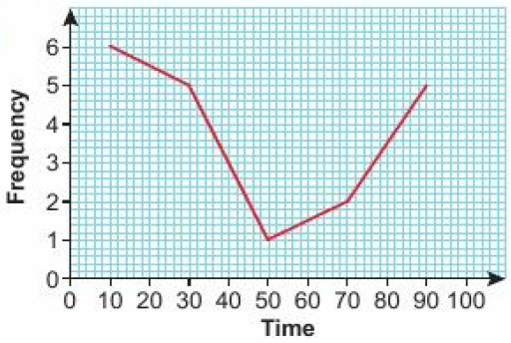
3 – Check Up
Page 636
a. Outlier £4800; range £4350
Outliers 22. 24; range 29.
a. 9.625 b. 5 ≤ x < 10 c. 25 d. 5 ≤ x < 10

Slide 48
3 – Check Up
Page 636
a. 5000
Seasonal variations in weather.
Sales of sun cream are generally increasing.
a. Positive b. i. 42 ii. 96 c. Part i, because part ii is outside the data points.

Slide 49
3 – Check Up
Page 636
a. b Students’ own answers.
The new mean is 3 more than the old mean.
Old mean = $\frac{w + x + y + z}{4}$ New mean = $\frac{\left(w+3\right)+ \left(x+3\right)+ \left(y+3\right)+ (z+3)}{4}$ = $\frac{w + x + y + z+12}{4}$ = $\frac{w + x + y + z}{4}$ + 3 = old mean + 3
Mean is multiplied by c New mean = $\frac{c(w + x + y + z)}{4}$ = c x old mean

Slide 50
3 – Strengthen
Page 636
Statistical diagrams
a. 36 b. 10
No; the proportions are the same but the numbers are different. 5 boys and 9 girls chose badminton.
a. 35 b. 20 c. $\frac{1}{2}$
a. 2 b. 6 c. 14
 | Yes | No | Total
Boys | 2 | 4 | 6
Girls | 3 | 11 | 14
Total | 5 | 15 | 20

Slide 51
3 – Strengthen
Page 636
a. 10 b. 14 minutes c. 2 d. 46 minutes by a girl
a. Key
i. Both sets have a median of 30 ii. Sets A and B have a range of 29 and 14 respectively,
Set A has a much higher range than Set B, but the medians are the same.
Set A |  |  |  |  | Set B
 |  | 7 | 0 | 2 | 6 | 8 | 8
8 | 2 | 0 | 0 | 3 | 2 | 3
 |  |  | 9 | 4 | 0
7 | 2 Represents 27
2 | 6 Represents 26

Slide 52
3 – Strengthen
Page 637
a.
Time | 0 ≤ t < 2 | 2 ≤ t < 4 | 4 ≤ t < 6 | 6 ≤ t < 8 | 8 ≤ t < 10
Frequency | 1 | 3 | 9 | 5 | 2
Mid-points | 2 | 3 | 5 | 7 | 9

Slide 53
3 – Strengthen
Page 637
a.
Averages and range
a. 46cm
He has probably misread the length during the experiment or has forgotten to put the decimal point in.
Mid-point | 0.5 | 1.5 | 2.5 | 3.5 | 4.5
Interval | 0 ≤ t < 1 | 2 ≤ t < 2 | 4 ≤ t < 3 | 6 ≤ t < 4 | 8 ≤ t < 5
Frequency | 1 | 2 | 4 | 5 | 3

Slide 54
3 – Strengthen
Page 637
a. b.
22.6cm
Lengths (L cm) | Frequency | Mid-point | Frequency x Mid-point
0 ≤ L < 10 | 7 | 5 | 7 x 5 = 35
10 ≤ L < 20 | 12 | 15 | 12 x 15 = 180
20 ≤ L < 30 | 20 | 25 | 20 x 25 = 500
30 ≤ L < 40 | 8 | 36 | 8 x 36 = 280
40 ≤ L < 50 | 3 | 45 | 3 x 45 = 135
Total | 50 |  | 1130

Slide 55
3 – Strengthen
Page 637
a. 300 b. 6% Mean speed = 26mph (to the nearest whole number)
a. 20 ≤ L < 30 b. 25 ≤ x < 30
Speed (x mph) | Frequency | Mid-point | Frequency x Mid-point
0 ≤ x < 20 | 8 | 10 | 8 x 10 = 80
20 ≤ x < 25 | 90 | 22.5 | 90 x 22.5 = 2025
25 ≤ x < 30 | 184 | 27.5 | 90 x 27.5 = 5060
30 ≤ x < 40 | 18 | 5 | 18 x 5 = 630
Total | 300 |  | 7795

Slide 56
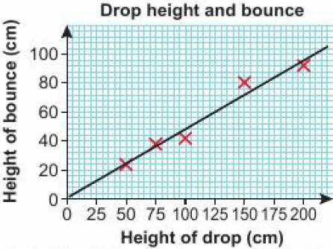
3 – Strengthen
Page 637
a. 20 ≤ L < 30 b. 25 ≤ x < 30
Scatter graphs and time series
a. Zero correlation b. Negative correlation c. Positive correlation
a. d.
As the height of the drop increases the height of the bounce increases.
Positive correlation
About 60 cm

Slide 57
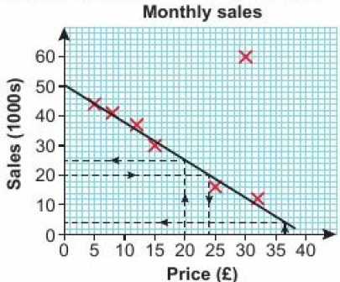
3 – Strengthen
Page 637
a. d.
(30, 60)
Negative correlation; as price increases sales decrease,
About 25000
About 4000
i is more reliable because it is inside the range of data points whereas ii is outside.
About £24

Slide 58
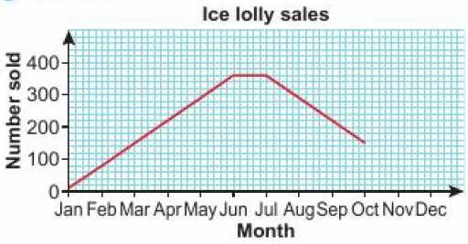
3 – Strengthen
Page 637
a.
Sales rise steadily until June when they remain constant for a month before decreasing at the same steady rate.
November 80, December 10

Slide 59
3 – Extend
Page 638
a. C and D; both points have the same y- coordinate
B; D is a lot more expensive than B but heavier
A and B; they lie on a straight line from the origin they are in direct proportion,
E; it is the most expensive but almost the smallest bag.
No correlation
a. Negative b. Positive c. Positive
a. 7 b. 12

Slide 60
3 – Extend
Page 638
a. 8kg b. 4
Yes, greenhouse mean yield id 6.5kg and the mean yield outdoors is 3kg.
a. 28.46; the raw marks are unknown,
$\frac{50+1}{2}$ = 25.5 so the median is halfway between the 25th and 26th items. The first two groups contain 16 and the next one has 22 so the median is in the third group, 26-30.
20
i. Decrease ii. Increase

Slide 61
3 – Extend
Page 838
a. 36 b. There might be more students in Year 11.
a. 40
Women's ages are uniformly spread out whereas men’s ages are concentrated in the 30-59 age range.
Women |  |  | Men
 | 9 | 0 | 8
 | 6 | 1 | 2 | 8
3 | 1 | 2 | 1 | 6 | 7
 | 1 | 3 | 1 | 4 | 7 | 9
8 | 5 | 4 | 0 | 0 | 0 | 2 | 5
8 | 3 | 5 | 0 | 7 | 7 | 8
4 | 2 | 6 | 2 | 3 | 4
 | 7 | 7 | 0
2 | 1 | 8 | 3
Key Women
6 | 1 Represents 16 years
Key Men
1 | 2 Represents 12 years

Slide 62
3 – Extend
Page 838
a. (15, 22) and (55,15) correctly plotted
Negative correlation; as temperature increases, time decreases.
Answer in 18-20 range
Either ‘Outside range of data points' or 'Line of best fit gives negative time',

Slide 63
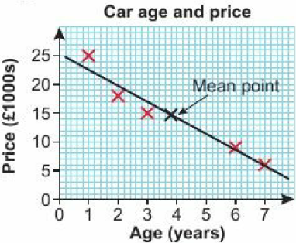
3 – Extend
Page 838
a. Negative correlation
38 c. 146 e. About £1100
It is outside the range of existing data points; new cars depreciate significantly in the first year.

Slide 64
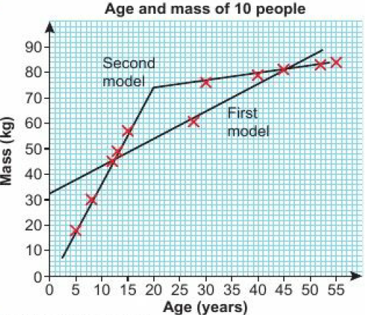
3 – Extend
Page 838
a.
Mean point (27.5, 60.2)
About 56kg d. About 75kg

Slide 65
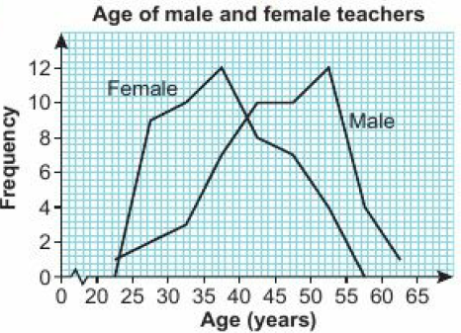
3 – Extend
Page 838
a.
The mean age of male teachers is 45.2 and the mean age of female teachers is 38.1 showing that male teachers are, on average, 7 years older than the female teachers.
The male frequency polygon is to the right of the female frequency polygon.

Slide 66
3 – Extend
Page 838
a.
55% c. 66.7% (1 d.p.) d. 62.5%
 | Under £30000 | At least £30000 | Total
Men | 60 | 30 | 90
Women | 60 | 50 | 110
Total | 120 | 80 | 200
 | Music | Drama | Sport | Total
Boys | 35 | 21 | 39 | 95
Girls | 30 | 28 | 32 | 90
Total | 65 | 49 | 71 | 185

Slide 67
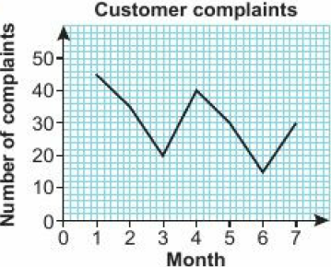
3 – Extend
Page 838
a. i. 50% ii. 23% b. 29.6% (1 d.p.)
Pie chart, because the other options cannot be used to display qualitative data.
a.
$\frac{45+35+20}{3}$ = $\frac{100}{3}$ = 33.3 (1 d.p.)

Slide 68
3 – Extend
Page 838
a.
$\frac{45+35+20}{3}$ = $\frac{100}{3}$ = 33.3 (1 d.p.)
$\frac{35+20+40}{3}$ = $\frac{95}{3}$ = 31.7 (1 d.p.)
decreasing
Months | 1-3 | 2-4 | 3-5 | 4-6 | 5-7
Moving average (1 d.p.) | 33.3 | 31.7 | 30 | 28.3 | 25

Slide 69
3 – Extend
Page 639
a. 29, 35, 36, 38
The trend is tor an increase in prices.
x = 15

Slide 70
3 – Unit Test
Page 639
Sample student answer
Student A has got the answer correct,
Student B gets more marks, because they have shown correct working and only got the final calculation wrong. Student A has shown no working so gets no method marks.

